Slide 1

Sinhgad College of Engineering, Pune – 41.
Department of Electronics &Telecommunication Engineering
“Gas Detection and Accident Prevention System”
by
Name –
Tushar Joshi
Suhas Khobragade
Omkar Bhise
Seat no –
T190233123
T190233145
T190233189
Guide Prof .
Dr. S. A. Shirsat
25/04/2022
Sinhgad College of Engineering, Pune – 41.
Department of Electronics &Telecommunication Engineering

Slide 2
CONTENTS
Introduction
Problem Statement
Objective
Literature Survey
Block Diagram
Circuit Diagram
Selection Criterion of Components
Design Specifications and Calculations
Flowchart/Algorithm
Simulation and Testing
PCB Designing
Demonstration and Results
Conclusion
Future Scope
REFERENCES
25/04/2022
Sinhgad College of Engineering, Pune – 41.
Department of Electronics &Telecommunication Engineering

Slide 3
Introduction
Gas leaks are a common problem in households and industries.
Our solution detects leakage and shuts off power and gas to stop it from spreading.
The sensor unit uses a gas sensor to detect dangerous or flammable gases like LPG, Propane, Hydrogen, Methane, and Carbon Monoxide. It can also be used to sense other gases like iso-butane, propane, or even cigarette smoke.
25/04/2022
Sinhgad College of Engineering, Pune – 41.
Department of Electronics &Telecommunication Engineering

Slide 4
Problem Statement
“Due to the large use of LPG gas cylinders in homes for cooking and heating water, it can be said that LPG gas is an integral part of many people's lives. However, there have been cases in the past about accidents due to gas leakage. The purpose of this project is to provide a security system to prevent accidents caused by gas leakage.”
25/04/2022
Sinhgad College of Engineering, Pune – 41.
Department of Electronics &Telecommunication Engineering

Slide 5
Objective
Our project aims to detect such gas leaks and notifies homeowners and cut off the gas supply
The system also removes the gas from rooms where gas leakage has occurred.
25/04/2022
Sinhgad College of Engineering, Pune – 41.
Department of Electronics &Telecommunication Engineering

Slide 6
Literature Survey
Sr. No | Authors | Proposed Method | Advantages | Disadvantages
1. | Anshuman Gupta Prakash , Dr. Lovi Raj Singh, Dr. Rajesh Gehlot, Dr. Anita Beri A Wireless Home Safety Gas Leakage Detection System | The goal of this book is to explore and illustrate the programming and interfacing of Arduino with gas sensors and detect the leakage. | This system includes Global positioning system so that user can collect the data along with position which can be used to study the air quality index of different locations | High Cost
2. | Rahul Gupta, Shubham Meena, Salman Khan, Raghunandan Garg, Rahul joshi. GSM Based Gas Leakage Detection System | In this research paper authors have proposed the leakage detection and real time gas monitoring system. In this system, the gas leakage is detected and controlled by means of turn of the power supply and gas valve | In this project, after the leakage of gas is detected, the valve is automatically closed, thereby stopping the leakage | Proposed System Consumes More Power
25/04/2022
Sinhgad College of Engineering, Pune – 41.
Department of Electronics &Telecommunication Engineering
Sinhgad College of Engineering, Pune – 41.
Department of Electronics &Telecommunication Engineering

Slide 7
Literature Survey(2/4)
Sr. No | Authors | Proposed Method | Advantages | Disadvantages
3. | Luay Fraiwan, Khaldon Lweesy, Aya Bani-Salma, Nour Mani A Wireless Home Safety Gas Leakage Detection System | This paper represents a prototype for wireless gas leakage systems that can be used mainly in household safety and many other applications in the industry and environment | The use of a sensor that is sensitive to small changes of concentration provides an excellent tool to detect a gas leak as it can detect small concentrations down to 100 ppm. | The sensor used in the system may be affected by the surrounding temperature and humidity
4. | Ankit Sood, Babalu Sonkar, Atul Ranjan and Mr. Ameer Faisal Microcontroller Based LPG Gas Leakage Detector Using GSM Module ” by Ankit Sood, Babalu Sonkar, Atul Ranjan and Mr. Ameer Faisal | This paper presents a research work which is easy to use and gives remote indication to the user. The sensor used in this Research Work has excellent sensitivity combined with a quick fast response time. The system is highly reliable, tamper-proof and secure | In the long run the maintenance cost is very less | Relatively less accuracy
Sinhgad College of Engineering, Pune – 41.
Department of Electronics &Telecommunication Engineering
25/04/2022
Sinhgad College of Engineering, Pune – 41.
Department of Electronics &Telecommunication Engineering

Slide 8
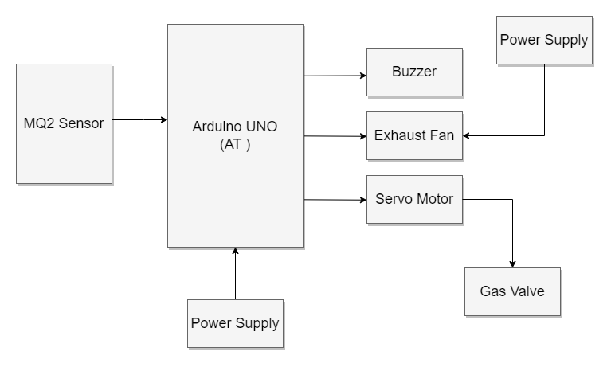
Block Diagram
25/04/2022
Sinhgad College of Engineering, Pune – 41.
Department of Electronics &Telecommunication Engineering

Slide 9
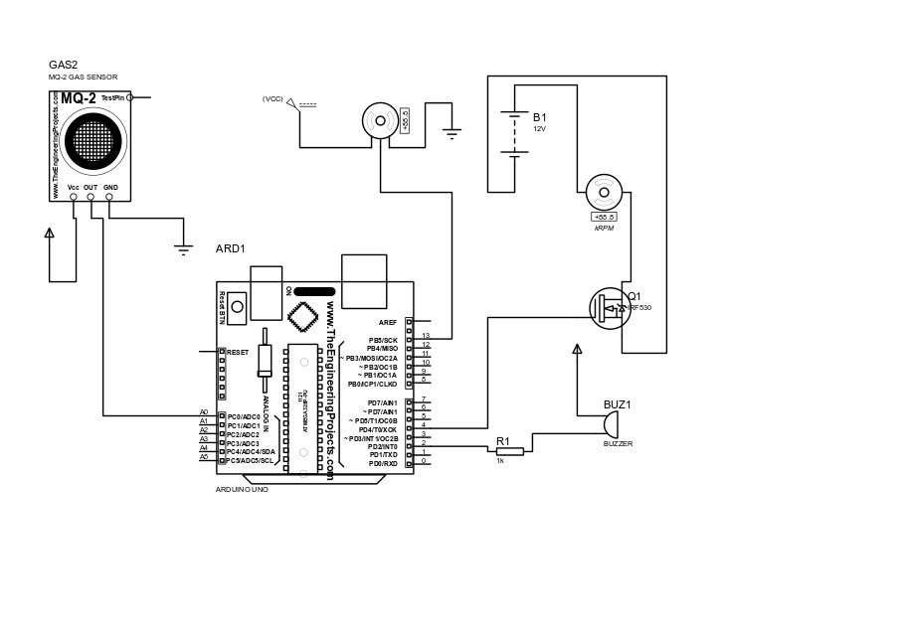
Circuit Diagram
Circuit Diagram of Gas Detector and Accident Prevention System
25/04/2022
Sinhgad College of Engineering, Pune – 41.
Department of Electronics &Telecommunication Engineering

Slide 10
Selection Criterion of Components
Microcontroller Selection Criteria
Parameter | Arduino Uno | Arduino Mega 2560 | Arduino Micro
Analog Pins | 6 | 16 | 12
Digital I/O Pins | 14 | 54 | 20
Processor | ATmega328P | ATmega2560 | ATmega32U4
Clock Speed | 16MHz | 16MHz | 16MHz
Flash Memory (kB) | 32 | 256 | 32
SRAM (kB) | 2 | 4 | 2.5
25/04/2022
Sinhgad College of Engineering, Pune – 41.
Department of Electronics &Telecommunication Engineering

Slide 11
Selection Criterion of Components
Sensor Selection Criteria
Sensors | Detects | Voltage
MQ2 | Methane, Butane, Propane, LPQ, Smoke | 5V
MQ3 | Alcohol, Ethanol, Smoke | 5V
MQ4 | Methane, CNG | 5V
MQ5 | Natural Gas, LPG | 5V
MQ6 | LPG, Butane | 5V
MQ7 | Carbon Monoxide | Alternating 5V & 1.4V
MQ8 | Hydrogen | 5V
25/04/2022
Sinhgad College of Engineering, Pune – 41.
Department of Electronics &Telecommunication Engineering

Slide 12
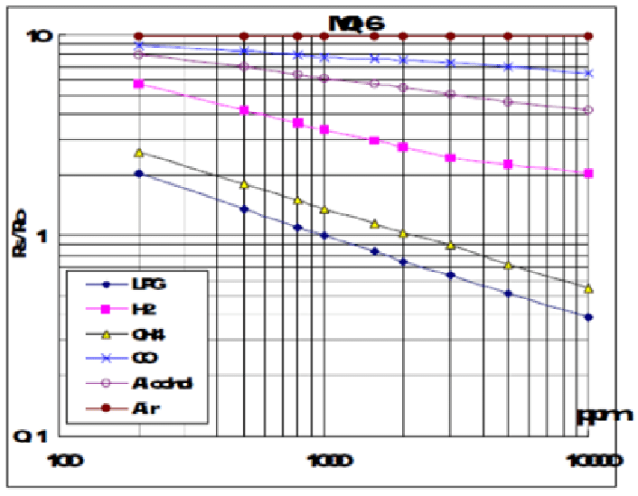
Design Specifications and Calculations
Sensitivity Characteristics of the Gas sensor
25/04/2022
Sinhgad College of Engineering, Pune – 41.
Department of Electronics &Telecommunication Engineering

Slide 13
1) Resistance of the surrounding air.
Ro = Rs (sensed resistance of the surrounding air) / Ro (resistance of the clean air)
2) The Rs is determined using following equation:
Rs = (Vc/VRL-1)×RL (from data sheet)
3) Behaviour of the sensor at different gas concentration.
= Rs/R0
Calculations:
Slope of the curve
= (Y1 – Y) / (X1-X) )
= (log(0.18)-log(2))/(log(1000)-log(200))
= ( -0.744 – 0.255 ) / ( 4 – 2.3 )
= -0.587
25/04/2022
Sinhgad College of Engineering, Pune – 41.
Department of Electronics &Telecommunication Engineering

Slide 14
To calculate output voltage,
Rs = (Vc-RL)/Vout + RL
i.e Vout = (Vc + RL)/(Rs+RL)
where,
Vc = Input Voltage ( in this case 5V )
Vout = output voltage
RL = Load resistance (20K)
Rs = Measured change in resistance when gas is detected ( 1K )
Vout = ( 5+ 20000 )/ ( 1000+20000)
=0.95 V
25/04/2022
Sinhgad College of Engineering, Pune – 41.
Department of Electronics &Telecommunication Engineering

Slide 15
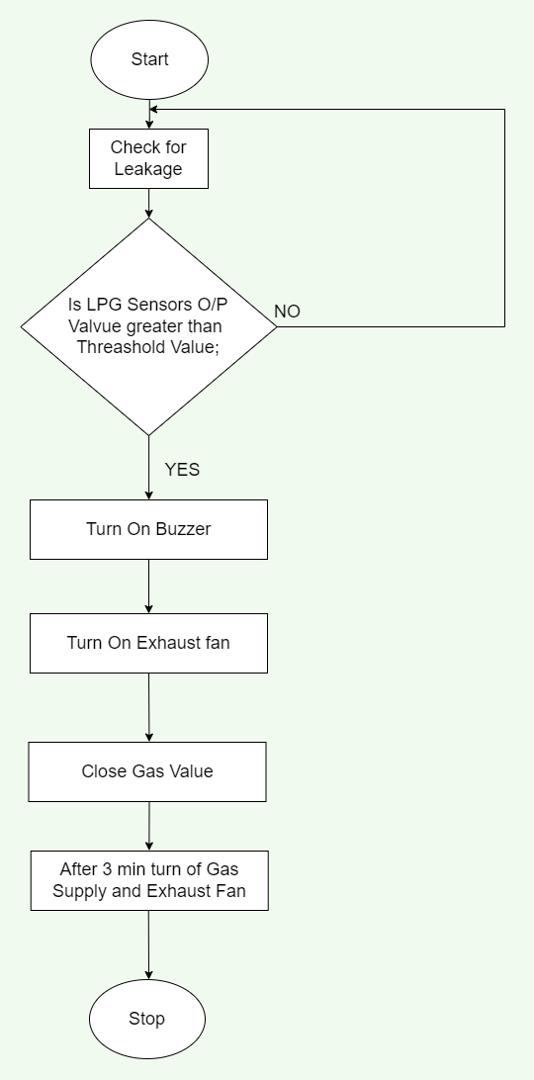
Flowchart/Algorithm
Algorithm :
Start
Power ON the system.
Compare the LPG sensor's value with the threshold value.
If the sensed value is greater than the threshold value then turn ON the Buzzer and the exhaust fan by enabling the port.
Rotate the servo motor.
If the sensed value is less than the threshold value then sense again.
Stop
25/04/2022
Sinhgad College of Engineering, Pune – 41.
Department of Electronics &Telecommunication Engineering

Slide 16
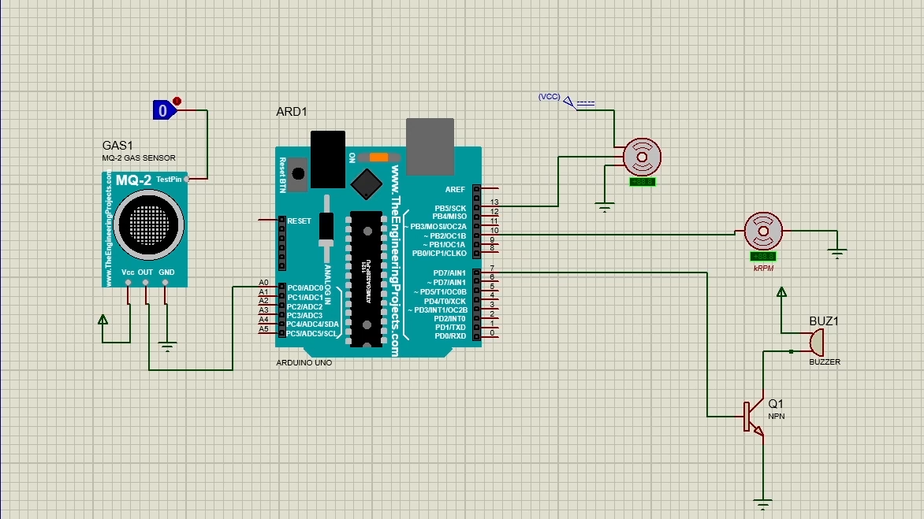
Simulation and Testing
Before
25/04/2022
Sinhgad College of Engineering, Pune – 41.
Department of Electronics &Telecommunication Engineering

Slide 17
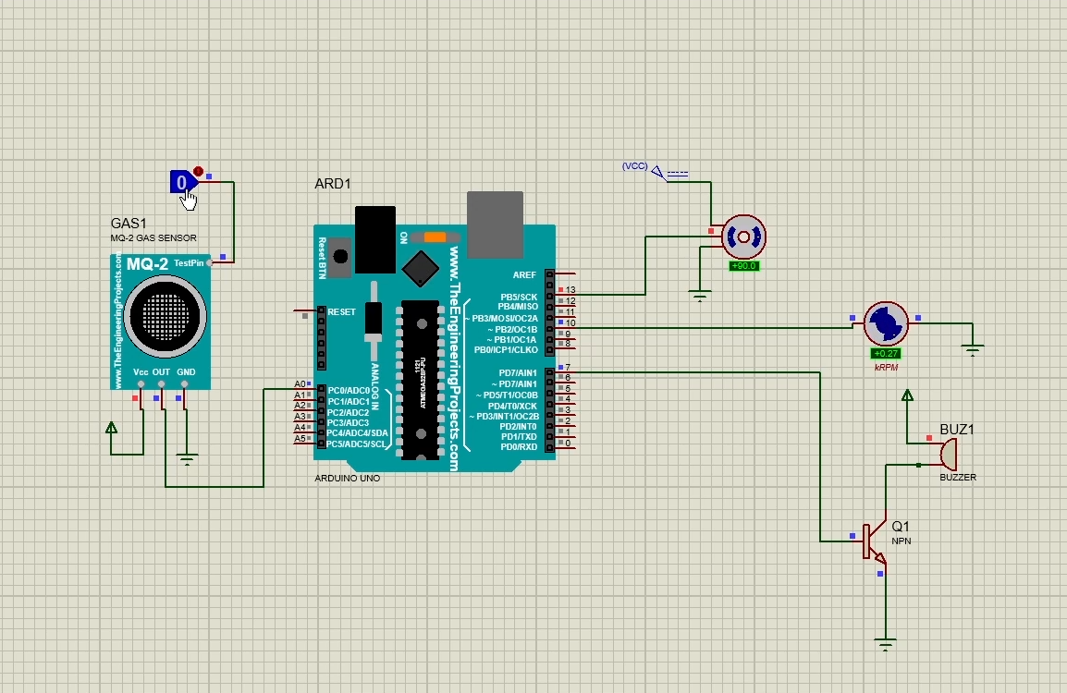
After
25/04/2022
Sinhgad College of Engineering, Pune – 41.
Department of Electronics &Telecommunication Engineering

Slide 18
25/04/2022
Sinhgad College of Engineering, Pune – 41.
Department of Electronics &Telecommunication Engineering

Slide 19
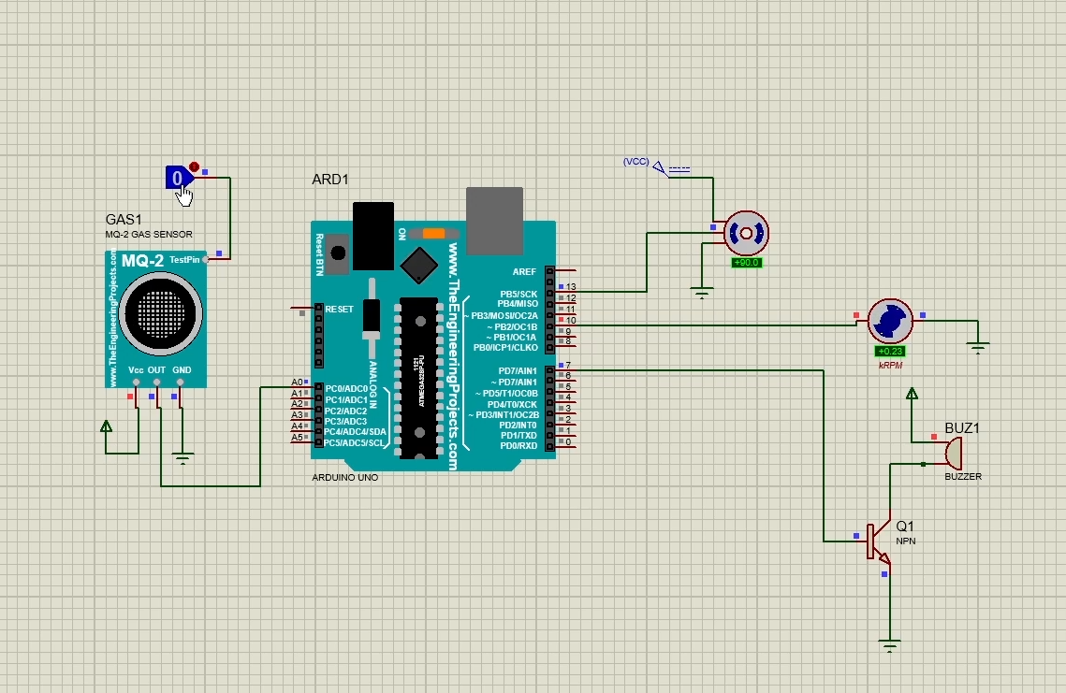
25/04/2022
Sinhgad College of Engineering, Pune – 41.
Department of Electronics &Telecommunication Engineering

Slide 20
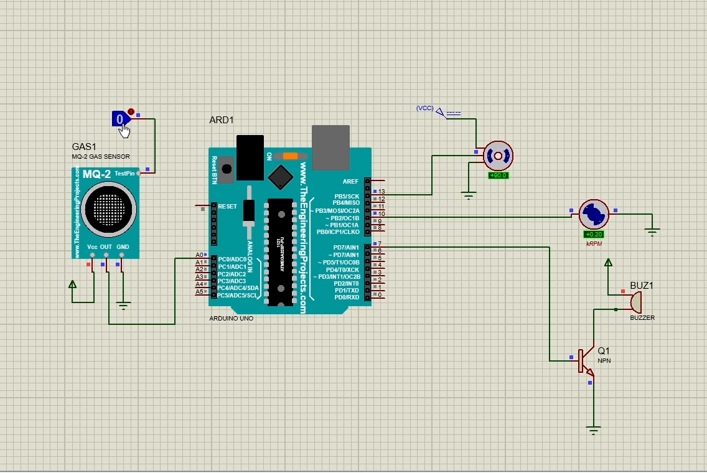
25/04/2022
Sinhgad College of Engineering, Pune – 41.
Department of Electronics &Telecommunication Engineering

Slide 21

25/04/2022
Sinhgad College of Engineering, Pune – 41.
Department of Electronics &Telecommunication Engineering

Slide 22
Applications
System can be used in home, restaurants & Industries.
25/04/2022
Sinhgad College of Engineering, Pune – 41.
Department of Electronics &Telecommunication Engineering

Slide 23
Conclusions
This system provides a fast, cost-effective solution to prevent gas leak repercussions by reducing the risk of explosion and fire.
It can collect gas leaks directly at the source and prevent them from reaching dangerous concentrations.
The statistics of concentration of gas collected on the application can be useful in detecting faulty valves and regulators before replacement is required.
A two-level prevention mechanism makes this system more reliable than others.
The cost involved in developing this system is significantly low.”
25/04/2022
Sinhgad College of Engineering, Pune – 41.
Department of Electronics &Telecommunication Engineering

Slide 24
Future Scope
Gas Detection and Accident Prevention System can be further enhanced by using GSM to send the alert messages to user, which supports another real-time application.
From industrial sector, the data collected by the mobile application is beneficiary and used for data analytics.
The integration of other sensors like temperature, pressure sensors etc. makes the system as a home automation project.
25/04/2022
Sinhgad College of Engineering, Pune – 41.
Department of Electronics &Telecommunication Engineering

Slide 25
REFERENCES
V Suma, Ramya R Shekar, Kumar A Akshay , “ Gas leakage detection based on IOT ”, International conference on Electronics, Communication and Aerospace Technology (ICECA), 1312-1315, 2019.
Ashish Shrivastava, Ratnesh Prabhaker, Rajeev Kumar & Rahul Verma, “ GSM Based Gas Leakage Detection System ” , International Journal of Emerging Trends in Electrical and Electronics (IJETEE – ISSN: 2320-9569)) , 2016.
Ankit Sood, Babalu Sonkar, Atul Ranjan and Mr. Ameer Faisal, “ Microcontroller Based LPG Gas Leakage Detector Using GSM Module ”, International Journal of Electrical and Electronics Research 3 (2),264-269,2015.
Prof.M.Amsaveni, A.Anurupa, R.S.Anu Preetha, C.Malarvizhi, and M.Gunasekaran “ GSM based LPG leakage detection and controlling system. ”, The International Journal Of Engineering And Science (IJES ISSN: 2319 – 1805)), 2015.
Anusha, Dr. Shaik Meeravali, “ Detection Of Gas Leak And Its Location Using Wireless Sensors ”International Journal of Engineering Research & Technology (IJERT) Vol. 1 Issue 9, November- 2019
05/04/2022
Sinhgad College of Engineering, Pune – 41.
Department of Electronics &Telecommunication Engineering

Slide 26
Thank You !!
25/04/2022
Sinhgad College of Engineering, Pune – 41.
Department of Electronics &Telecommunication Engineering

